Slide 1

Chapter 7 Transmission Media

Slide 2
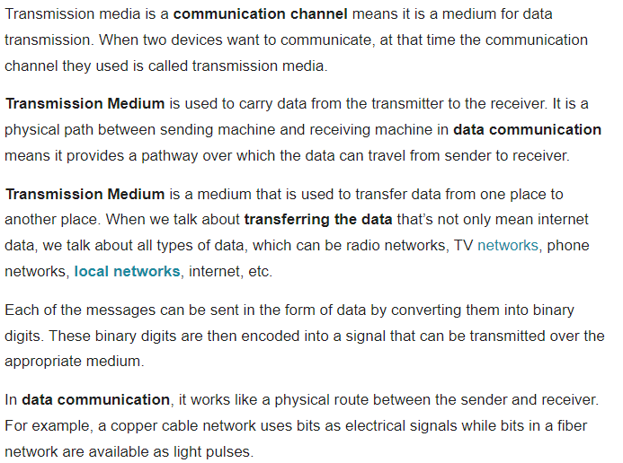
TRANSMISSION MEDIUM

Slide 3
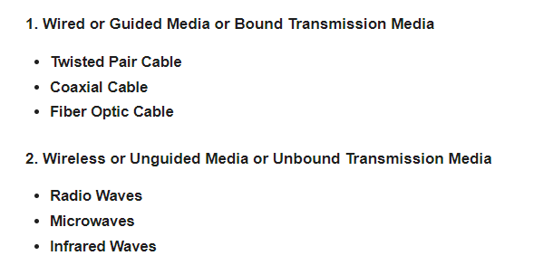
TYPES OF TRANSMISSION MEDIUM

Slide 4
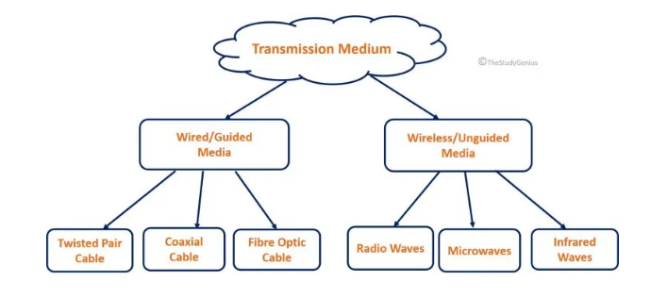

TYPES OF TRANSMISSION MEDIUM

Slide 5
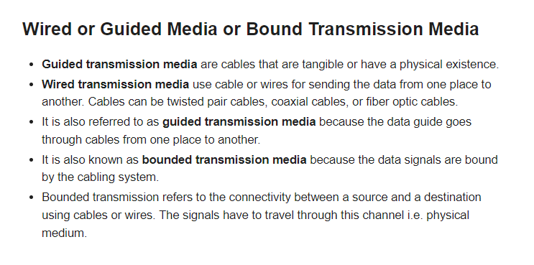
WIRED OR GUIDED OR BOUND TRANSMISION MEDIA

Slide 6
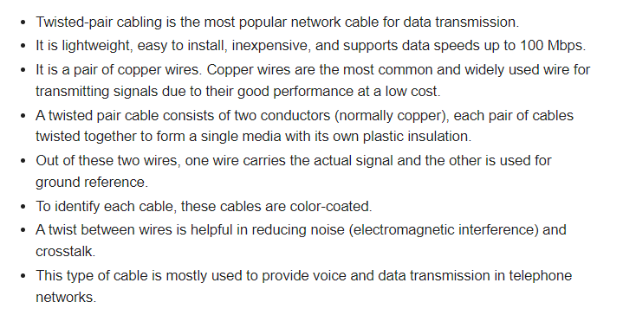
TWISTED PAIR CABLE

Slide 7


TWISTED PAIR CABLE

Slide 8
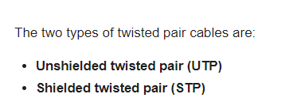
TYPES OF TWISTED PAIR CABLE

Slide 9
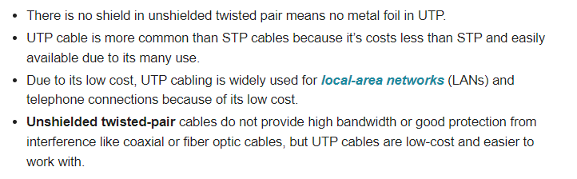
UNSHILDED-TWISTED PAIR CABLE(UTP)

Slide 10
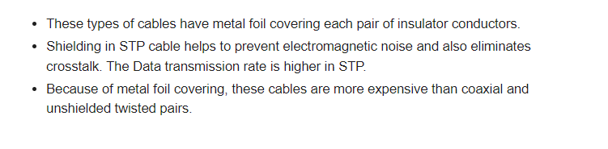
SHILDED TWISTED PAIR CABLE(STP)

Slide 11
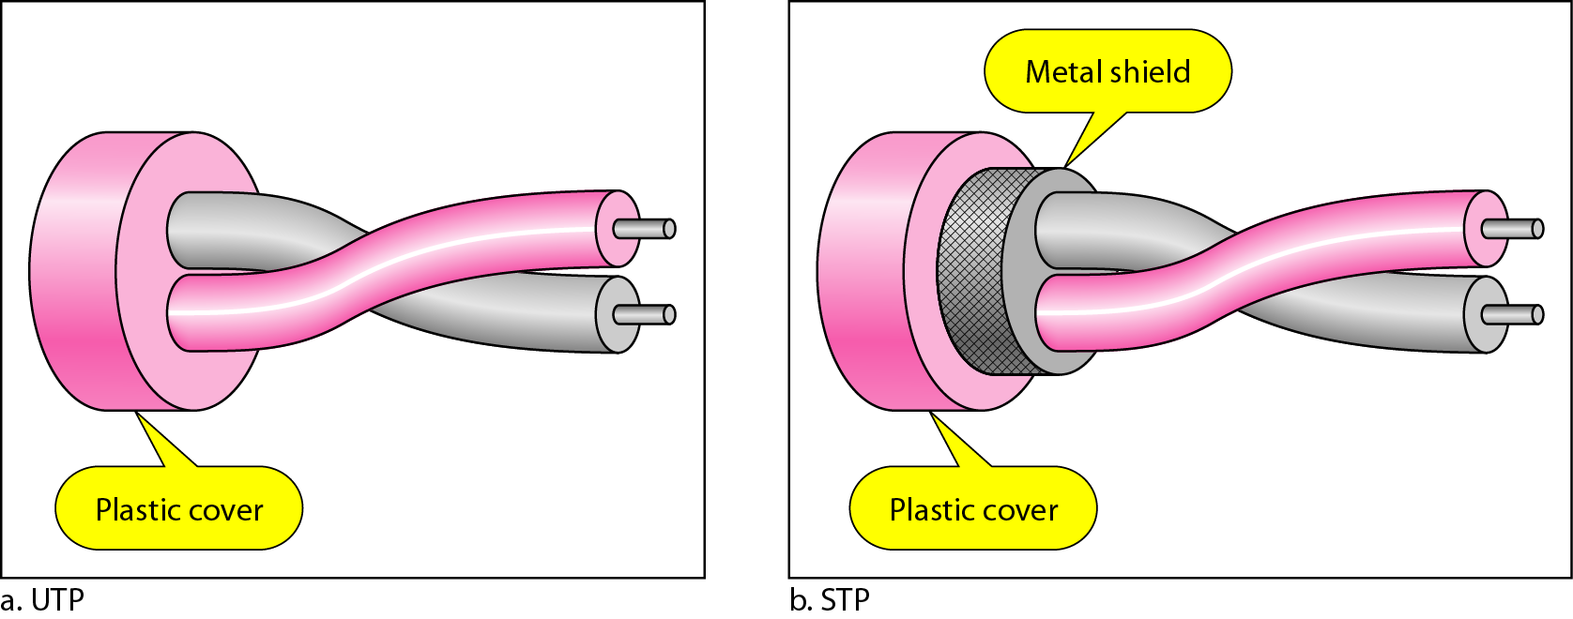
UTP & STP

Slide 12
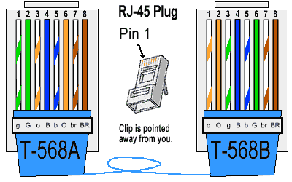

Slide 13
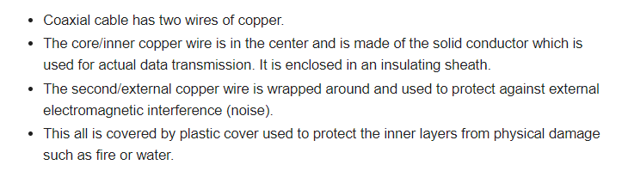
COAXIAL CABLE

Slide 14
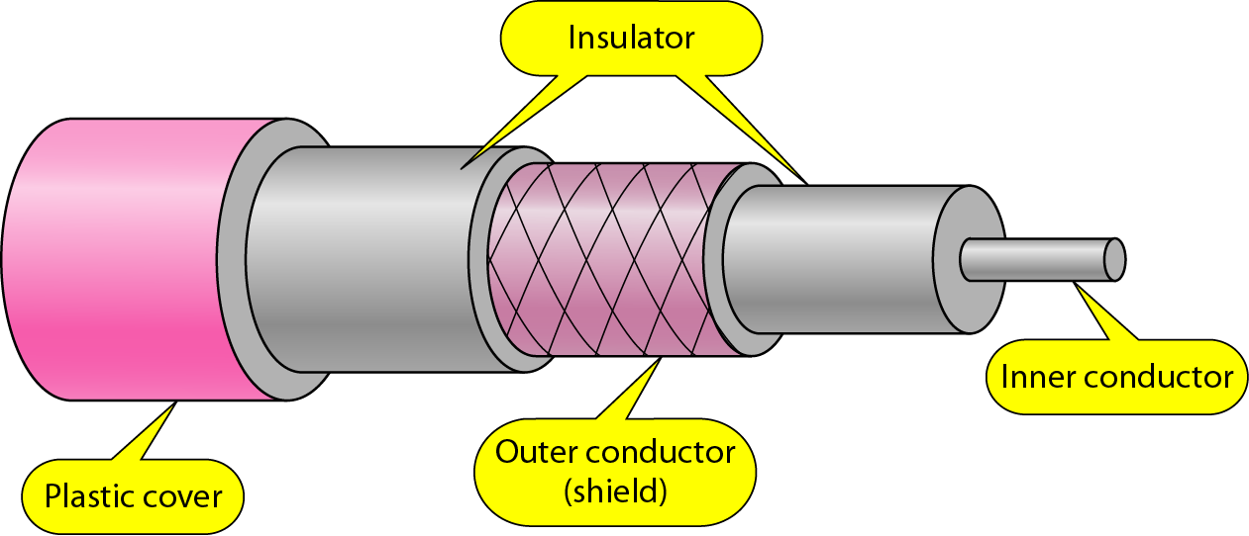

COAXIAL CABLE

Slide 15
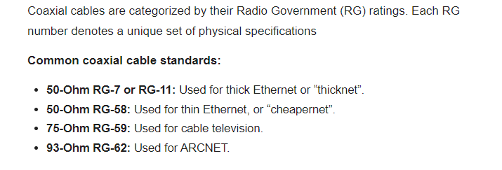
COAXIAL CABLE CATEGORIS

Slide 16

COAXIAL CABLE CATEGORIS

Slide 17
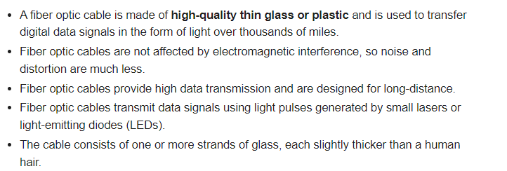
FIBER OPTIC CABLE

Slide 18
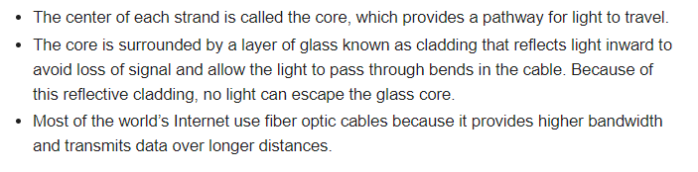
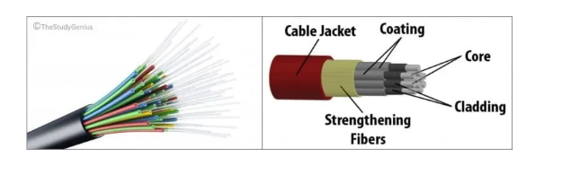
FIBER OPTIC CABLE

Slide 19
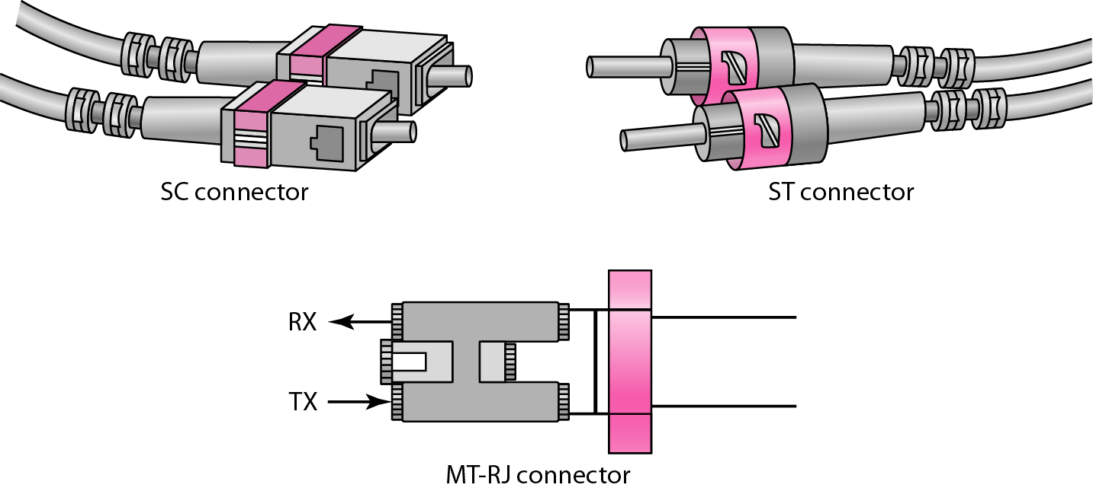


FIBER OPTIC CABLE

Slide 20
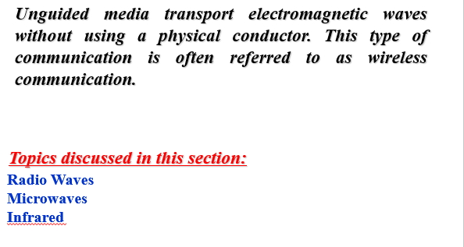
UNGUIDED MEDIA: WIRELESS

Slide 21
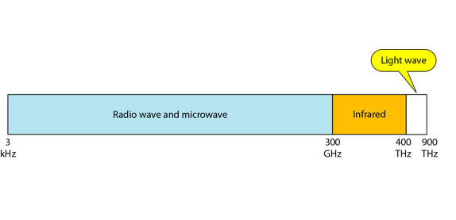
Electromagnetic spectrum for wireless communication

Slide 22
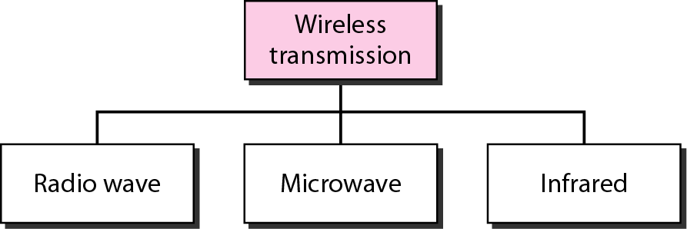
Wireless transmission waves

Slide 23
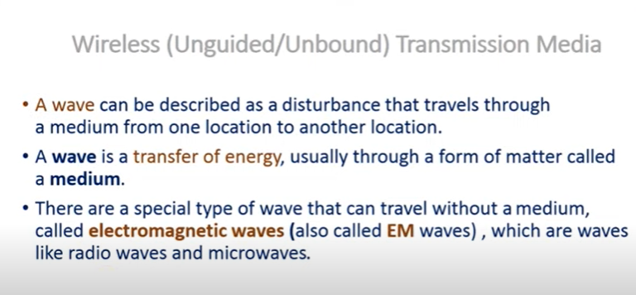
WIRELESS OR UNGUIDED MEDIA OR UNBOUND TRANSMISSION MEDIA

Slide 24
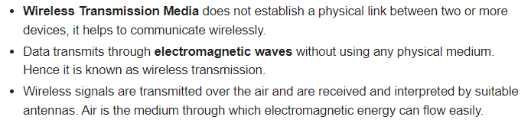
WIRELESS OR UNGUIDED MEDIA OR UNBOUND TRANSMISSION MEDIA

Slide 25
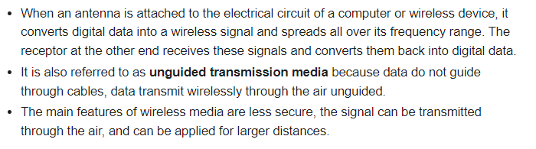
CONTINUED……

Slide 26
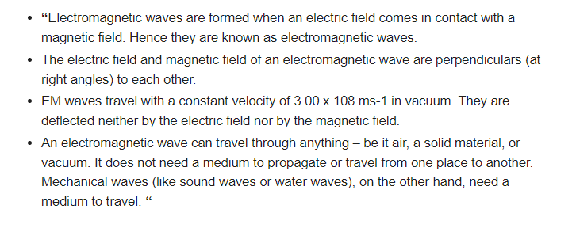
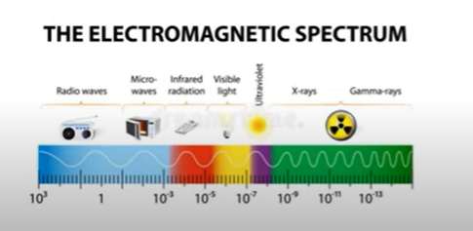
ELECTROMAGNETIC WAVES

Slide 27
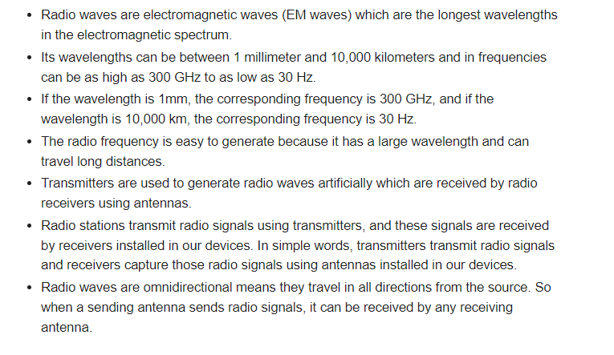

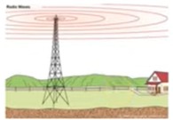
RADIO WAVES

Slide 28
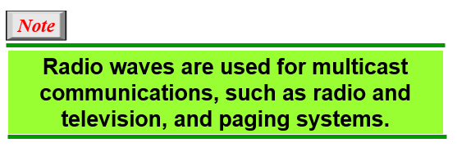

Slide 29
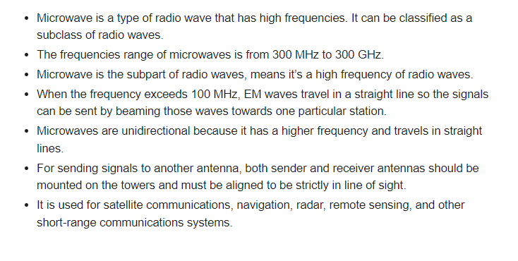
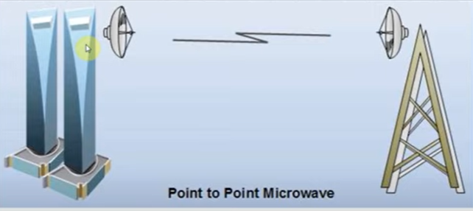
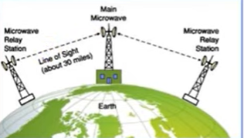
MICROWAVE

Slide 30
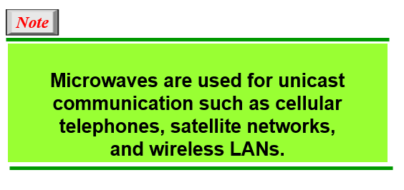

Slide 31
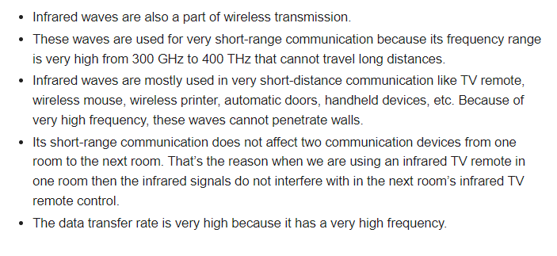

INFRARED WAVES

Slide 32
